Slide 1

Event staff manager
Sam Depauw
Viktor Walravens
Xander Vanderhaeghe
Louis De Veirman
Casper De Meester
Groep 30

Slide 2

Agenda
Situation & problem
User roles
Our features
Demonstration
Questions

Slide 3



Situation & Problem

Slide 4
User Journey - Manager
LOG IN
ACCEPT/REFUSE
CALENDAR OVERVIEW
STATISTICS
NEW EVENT
Notes:
Inloggen
Nieuw evenement
Accepteren/weigeren
Kalenderoverzicht
Statistieken

Slide 5

User Journey – Employee
LOG IN
APPLICATION
CALENDAR OVERVIEW
AVAILABILITY
Notes:
Inloggen
beschikbaarheid
solliciteren
Kalenderoverzicht

Slide 6

Our Features
Statistics
Ical
….

Slide 7
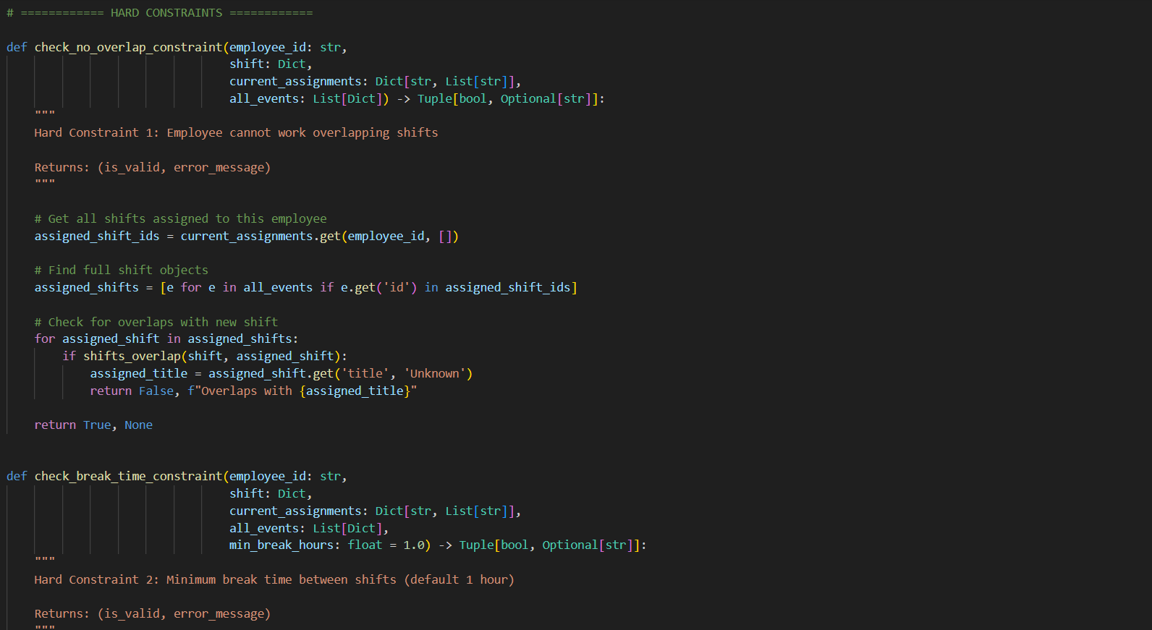
Our Algorithm
Hard Constraints:
1. No overlapping shifts per employee
2. Minimum 1-hour break between shifts
3. Maximum 12 hours per employee per day
4. Availability window constraints
5. Shift capacity must be met
Soft Constraints:
1. Fairness: even hour distribution (60% weight)
2. Availability match: shifts in preferred windows (40% weight)

Slide 8
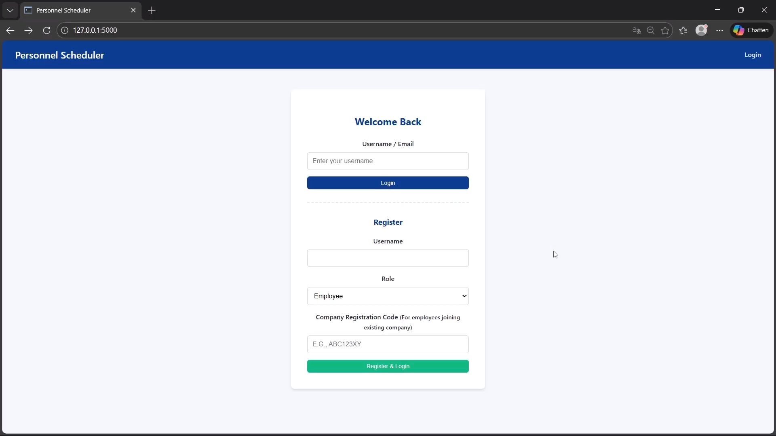
Demonstration

Slide 9

Questions?

